Slide 1
Rates of Reactions
Surface Area

Slide 2
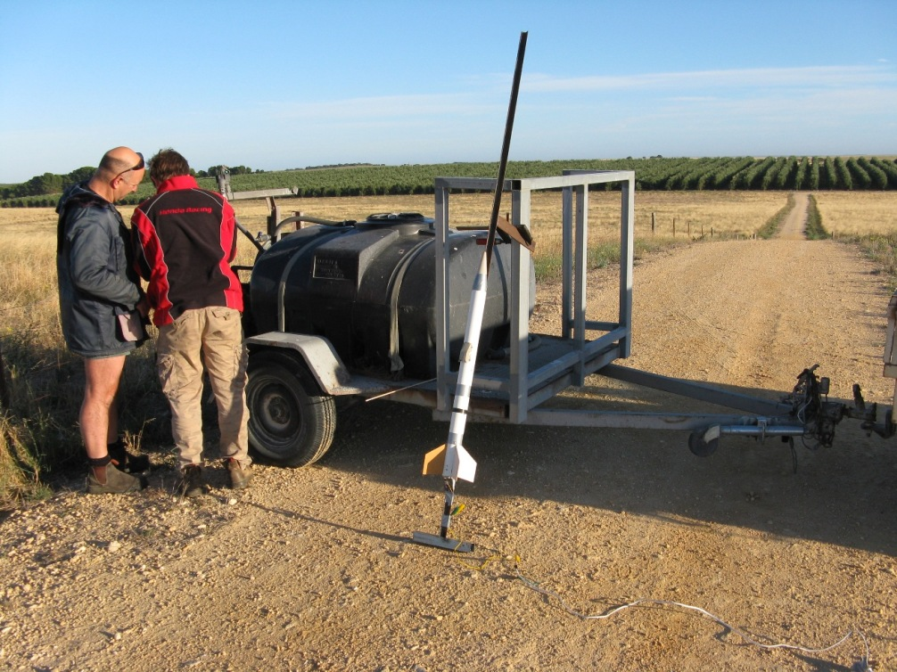
Rocket science?

Slide 3
A long time ago
Notes:
Friend of mine at a party was showing me his home made fireworks. Dangerous

Slide 4
Amateur Rocketry
Notes:
His design was quite simple:
Pvc pipe with dirt packed in one end to make a stoppper
Fill it with the rocket fuel and drill the inside out
Sticky tape a stick to it to make a stabiliser/something to stick it into the ground (think of how an arrow flies)
Wrap a sparkler around the stick and stick it inside the drilled out as a fuse
Light
Run
Watch the fireworks.

Slide 5
But what was in the rocket fuel?
Surprisingly easy to make
Very dangerous to make
Stay with chemistry until year 12 and maybe you too can work it out ☺

Slide 6
The rocket was impressive
Easy to construct
Ingredients readily available
Flew about 80m high
Could still be better
Fuel was still burning when the rocket hit the ground.

Slide 7
Our first attempt to improve the rocket
Did we want a faster or slower rate of reaction?
Faster, we wanted the burn to complete faster so there was more force to accelerate with on the way up.
We focussed firstly on the mixture. It’s possible to calculate the perfect mixture but it doesn’t burn like you would hope. Why?
Notes:
FIRST, ASK THE QUESTION

Slide 8
Surface Area
H2O (Water) Is made by igniting 2 Hydrogen atoms with 1 Oxygen atom
Lets say I had a container with exactly that mixture but it was arranged like this. Where would it burn? Would it burn fast or slow?
Hydrogen
Oxygen

Slide 9
The ideal explosion
2 Hydrogen atoms are close to every Oxygen atom
Hydrogen and Oxygen Distributed Evenly

Slide 10
Back to the rocket
Even though the perfect mix could be calculated, the actual mix was higher in one reactant so that there was always enough contact between the reactions to get a good explosion.
Left over is wasted at the cost of a fast burn.
Did the reactions with the timer get faster or slower if you gave the flask a stir before putting it down?

Slide 11
Cooking our rocket propellant
Mixing the ingredients together in powder form gets you only so far.
Molecules of reactants in tiny powder crystals needed a better surface area to burn fast
COOK
Notes:
Green is reactant A molecules
Grey is reactant B molecules

Slide 12
SAFETY

Slide 13
What might be the issue with trying to ‘cook’ our rocket propellant?

Slide 14
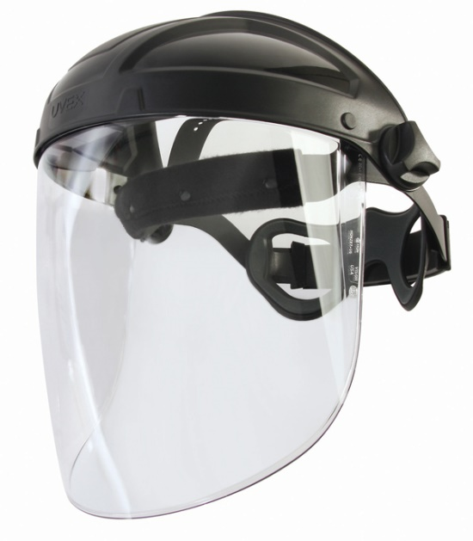
Safety Considerations
You’re cooking explosive material
If it gets too hot, molecules will have passed the required activation energy.
Literally could explode in your face.
We cooked it outside with a full glass face mask on an electric cooker with welding gloves.
Notes:
Safety is no joke. One time the rocket fuel did explode in the kitchen pot it was cooked in and it shot a fireball into the air that hit the roof outside.

Slide 15
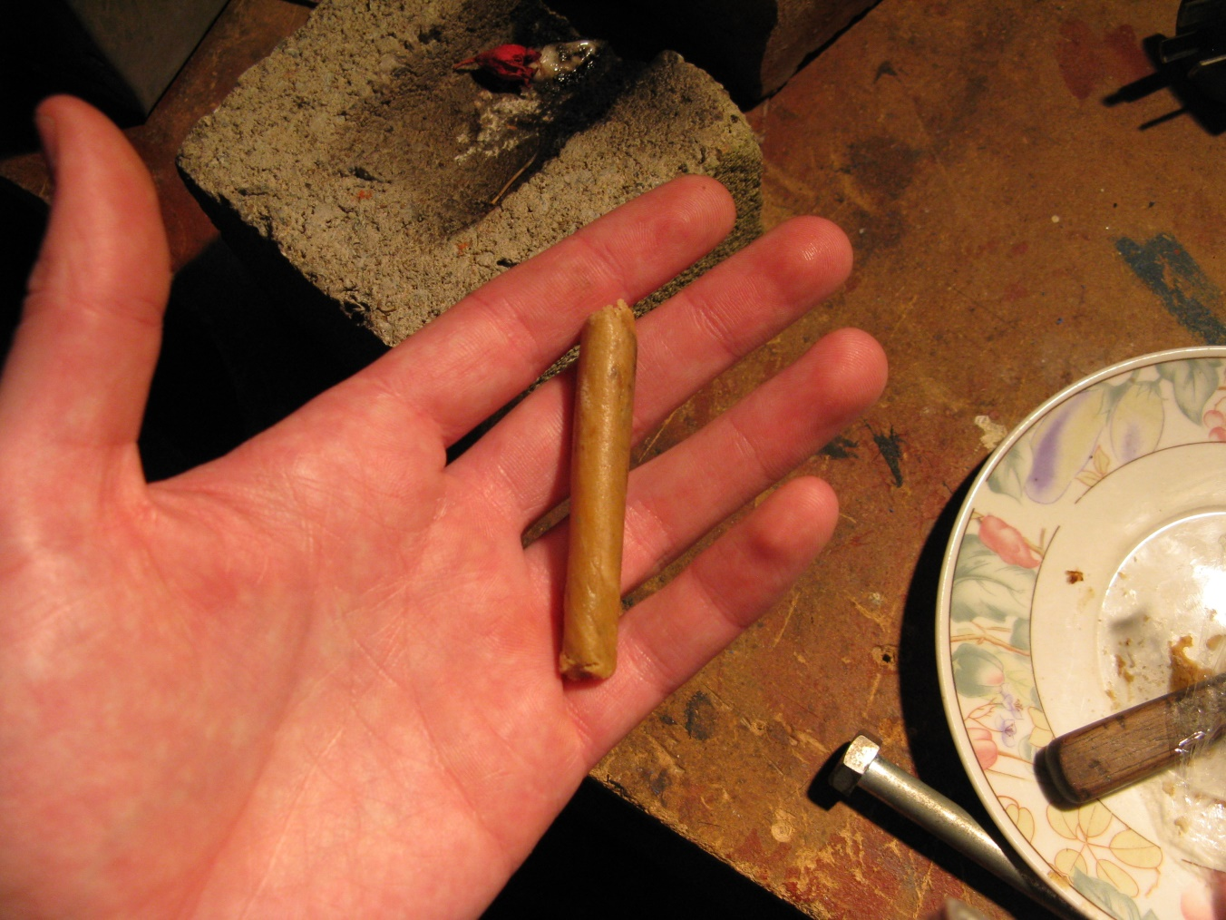
Rocket Testing

Slide 16
Rocket Testing
Different mixtures were cooked and casted into the same length ‘sausage’.
They were then timed to see how long it took to burn the stick end to end.
Does this process sound familiar?

Slide 17
Burn Test Video
Show Video 1

Slide 18
What improvements would you make?
The cooked mixture was poured into a cylindrical cast like the first rocket.
What else could you do to make that mixture burn faster?
Remember, rockets are basically a directed explosion.
2 minutes - discuss!
Rocket Fuel

Slide 19
Draw The Changes

Slide 20
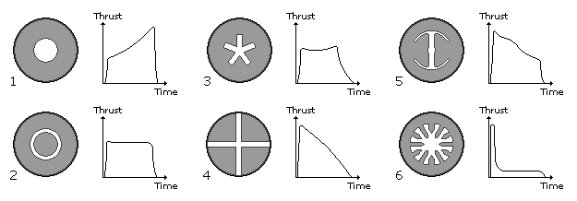
Surface area
We drilled out our rocket fuel so it looks like a circle. Other patterns are available for different purposes.
Remember, as the fire burns, different amounts of the fuel are exposed to the flame.

Slide 21
Pressure/Temperature
Adding a nozzle to the end of the chamber limits the flow of gas
This increases pressure
Increased pressure means increased number of collisions (similar to increasing temperature)
Supersonic air comes out the other side of the nozzle and expands, forcing the rocket up.

Slide 22
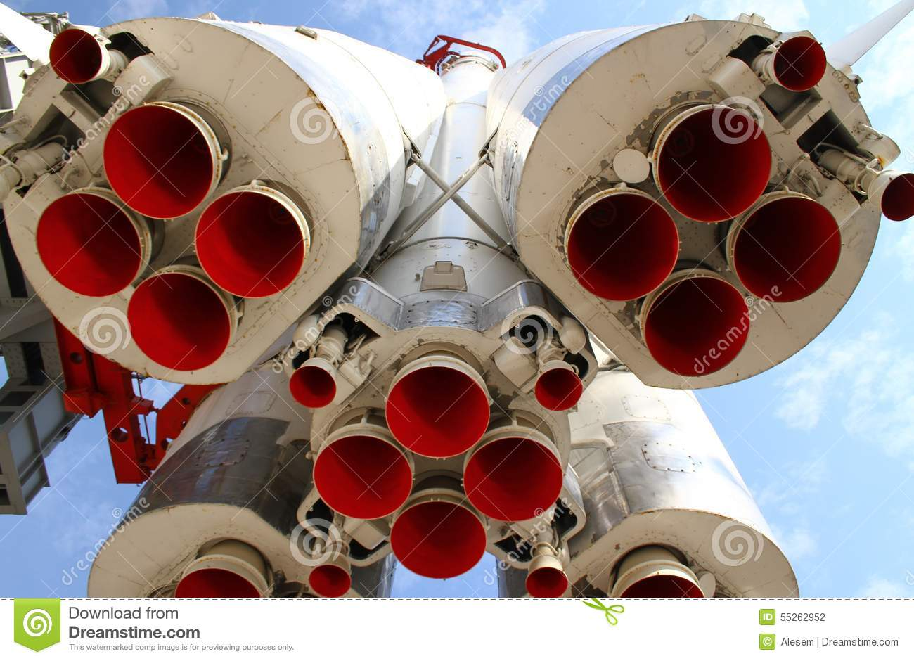

Slide 23
The end result?

Slide 24
The end result?

Slide 25
Take Home Message
Two materials will react faster with each other when there is more contact between the substances.
They have more ‘opportunity’ to react. They just need the energy to get started.
Think of the crystals in the rocket fuel as an excellent surface area contact
Think of rust on a block of iron which exists only on the outside where it has contact with oxygen.

